Slide 1
Distance Learning in Legal Education: Design, Delivery and Recommended Practices. “The Road Travelled & The Journey Yet Ahead” William Byrnes (Texas A&M) Jason Fiske (Thomas Jefferson) CALI June 18, 2015

Slide 2
Who is doing it?
48 online LL.M.s by 30 ABA law schools
ABA Standard 306 relaxation
ABA definition of DE
Hybrid JD of William Mitchell Hamline

Slide 3
Structure
Introduction
Delivery Mechanisms
Instructional Technology Tools
Assessment of Students, Courses and Programs
Student Orientation, Student Services, and Computer Access
Training and Technical Support
Institutional Integration and Administration
Intellectual Property Law as Applied in Distance Education
Professionalism Online
Accreditation and Regulation
Business and Financial Models

Slide 4
Chapter 1 Collecting Challenges, Solutions, and Best Practices for Deans, Faculty and Policymakers
3 Goals –
To define and summarize current topics and practices in legal distance learning;
To identify areas that need best practices developed, and, to the extent possible, describe current recommended practices; and
To identify areas that need further attention, research or development by the legal distance learning community.

Slide 5
Chapter 1 Collecting Challenges, Solutions, and Best Practices for Deans, Faculty and Policymakers
5 distinct domains of challenge –
i) educational theory & tech resources
ii) admin of distance learning programs
iii) tech training & management
iv) IP
v) business & financial models

Slide 6
Chapter 2: Delivery Mechanism
Delivery Models: Synchronous & Asynchronous. Strengths & operational considerations
Comparative Pedagogy: How do pedagogical practices differ between distance learning and residential programs?
How do synchronous and asynchronous pedagogy differ and complement one another?

Slide 7
Chapter 2: Delivery Mechanism
Hybrid or Blended Learning. How can distance learning and in-person teaching techniques or tools be deployed in concert to produce better student outcomes?
Staffing for Distance Learning Program Design. How do the design and delivery of online courses differ from residential course development and teaching? What particular personnel and skill sets are required to launch and maintain an online program?

Slide 8
Chapter 3: Instructional Technology Tools
“One common trap new online instructors and program designers discover is the temptation and excitement of new online tools.
While the number of technological tools proliferate, and increasingly novel approaches are introduced, instructors can be enticed to use technology for technology’s sake. Focus should always remain on using the best tool to achieve designated learning outcomes.”

Slide 9
Chapter 3: Instructional Technology Tools
Learning Management Systems
Webcasts and Video Feeds
Podcasts and Voice-Over-Slides
Chats and Blogs
Quizzes
Discussions
Wikkis

Slide 10
Chapter 3: Instructional Technology Tools
Webcasts
Site-to-site
Closed Broadcast
Open Broadcast
Visual Two-way vs. Visual One-way
Audio Two-way vs. Visual One-way

Slide 11
Chapter 4: Assessment of Students, Courses & Programs
Assessment of Student Performance.
Assessment of Course Effectiveness.
Assessment of Program Outcomes.

Slide 12
Chapter 4: Assessment & Feedback
Rubrics
Feedback
Peer Grading
Attendance as Assessment
Gradebook/Dashboard
Online Quizzes

Slide 13
Chapter 5: Student Orientation, Student Services & Computer Access
Orientation?
Student services? (Advising, Career Services, and Student Services Generally)
System requirements generally?
System requirements across multiple devices?

Slide 14
Chapter 6: Training & Technical Support
Faculty Training?
Student Training?
Support Staff Training?
Technical Staff Training?

Slide 15
Are Experts Born or Made?
Neuro Science
Learning Psychology
& Online Pedagogy

Slide 16
Why is this discussion interesting?
May expand the universe of pedagogical techniques for the legal educator’s toolkit
Exposure to other teaching methods and technologies
Understand overlap of neuro-science, learning psychology & cognition
Examples of outcome based course designs

Slide 17
Is it Legit?
“On average, students in online learning conditions performed better than those receiving face-to-face instruction.”
2009 U.S. Department of Education’s Evaluation of Evidence-Based Practices in Online Learning--A Meta-Analysis and Review of Online Learning Studies of the period 1996 through 2008 of university, graduate and professional studies, e.g. medical, technology, engineering and law

Slide 18
“Diverse groups of problems solvers
– groups of people with diverse tools –
consistently outperform groups of the best & the brightest”
= Perspectives & Collaboration

Slide 19
New Skills – New Learning*
knowledge management
(superior information gathering and discernment)
techno-social skills
(group work skill set)
*Berkman Center (Harvard) Study (Koo)

Slide 20
“Experts are made – not born”
How Long Does it Take?
What Does it Take?
Can We Make the Process More Efficient?

Slide 21
Technician v. Professional
Learn to Identically Repeat a Set of Tasks to Create a Result
Obtain a Body of Knowledge & Able to Apply to Changing Facts

Slide 22
Leveraging Distance Education
Communications Technology: Oral Tradition, to Codex, to Internet
Best Practices (See Distance Education Work Group)

Slide 23
How Information is researched and analyzed
Structure of law and legal analysis
Working knowledge of resources available
Identify appropriate sources of law

Slide 24
New Generation of Legal Research -How Information is researched and analyzed
Access of Legal Information expands or contracts the universe of perspectives and potential solutions
Crowd Sourcing, Concept Mapping, Algorithms, & Artificial Intelligence

Slide 25
How Information is researched and analyzed
New Legal Research Platforms are emulating Google which is “Crowd Sourcing”
Algorithms that track meaningful interactions with documents by all users of platform with results
Examples: WestNext & Lexis Advance search 40,000 databases, over 1 billion documents

Slide 26
Course Development
Law & Linguistics (linguistics in the context of language, as well as in the context of semiotics)
Contextualization: historical, sociological, economic

Slide 27
“Through the eye of a needle”
Cognitive Limit: 4 slots of active memory
Slot is active for 20 seconds absent long term memory acquisition techniques
Cognitive Protocols → Efficient Learning

Slide 28
“It’s all in the packaging”
Learning Frameworks
Schema
Matrices
Mind-mapping

Slide 29
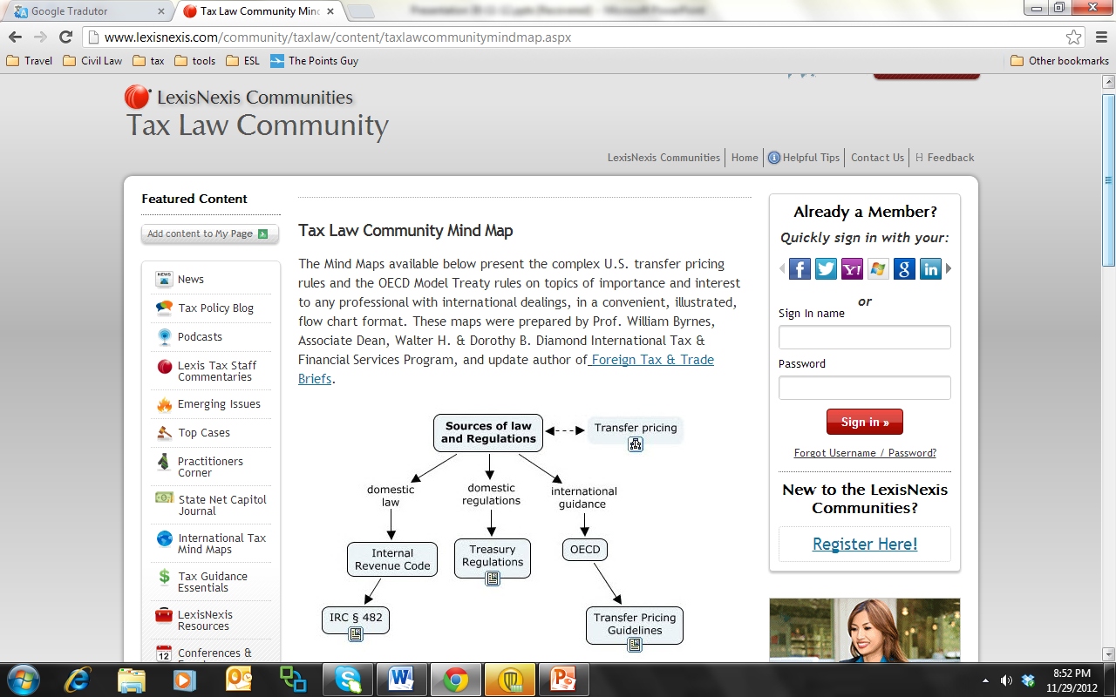

Slide 30
Memory Protocols
Chunking
Schematic
Hierarchical
Subjective organization
Encoding versus retrieval
Shallow versus deep
Cuing and cue-dependant learning

Slide 31
Contact Us?
Prof. William Byrnes, Texas A&M
williambyrnes@gmail.com
+1 (786) 271-5202
www.linkedin.com/in/williambyrnes/
Asst. Dean Jason Fiske, Thomas Jefferson
fiskeja@tjsl.edu
+1 (619) 961-4211

